Slide 1



AURORA
CECELIA LEE
12 AUG 2025

Slide 2
ABOUT
MY PROJECT
CONCEPT 01
DEFINATION 02
FACT 03
An interactive web-based synthesizer that merges music creation with real-time visual art.
Audio Engine: Polyphonic synthesizer (Tone.js) with 8 notes (C4–C5).
Visualizer: Physics-based particle system that reacts to notes/metronome.
Goal: Make music creation immersive through responsive visuals.
Built with only JavaScript and Web Audio API.

Slide 3
WHY THIS PROJECT
MUSIC AND GENERATIVE ART IN A BROWSER.
Explore the Web Audio API and collision physics.
MOTIVATION:
AURORA
DIGITAL AUDIO WORKSTATIONS (DAWS) LIKE ABLETON.
Visualizers like Winamp MilkDrop, touchdesigner
INSPIRATION:
RESEARCH:
STUDIED TONE.JS DOCUMENTATION FOR SYNTH DESIGN.
ANALYZED PARTICLE COLLISION ALGORITHMS.
GOAL ACHIEVED:
ITS A NO INSTALL TOOL FOR PLAYFUL MUSIC EXPLORATION.
03

Slide 4

How it works?
- Tone.js (Audio)
- CSS/HTML
Tools used
1. User Input: Keys (A-K) trigger notes.
2. Audio: Tone.js generates sounds with ADSR envelopes.
3. Visuals: Canvas renders particles that collide/fade.
4. Metronome: Adjustable BPM with pulse feedback.
Block diagram
KEYBOARD
INPUT
AUDIO ENGINE
VISUAL ENGINE
04 project requirements
04

Slide 5

DEMO

Slide 6
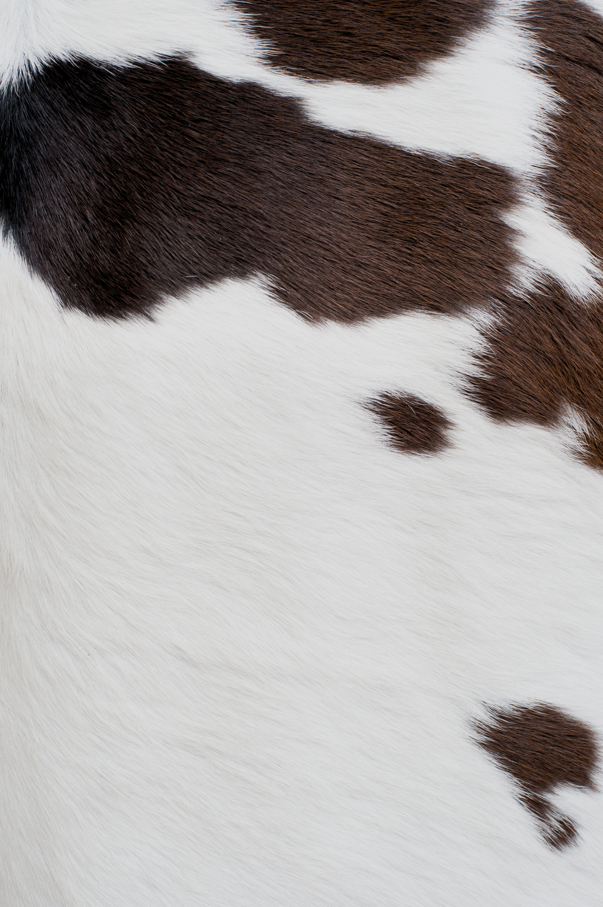
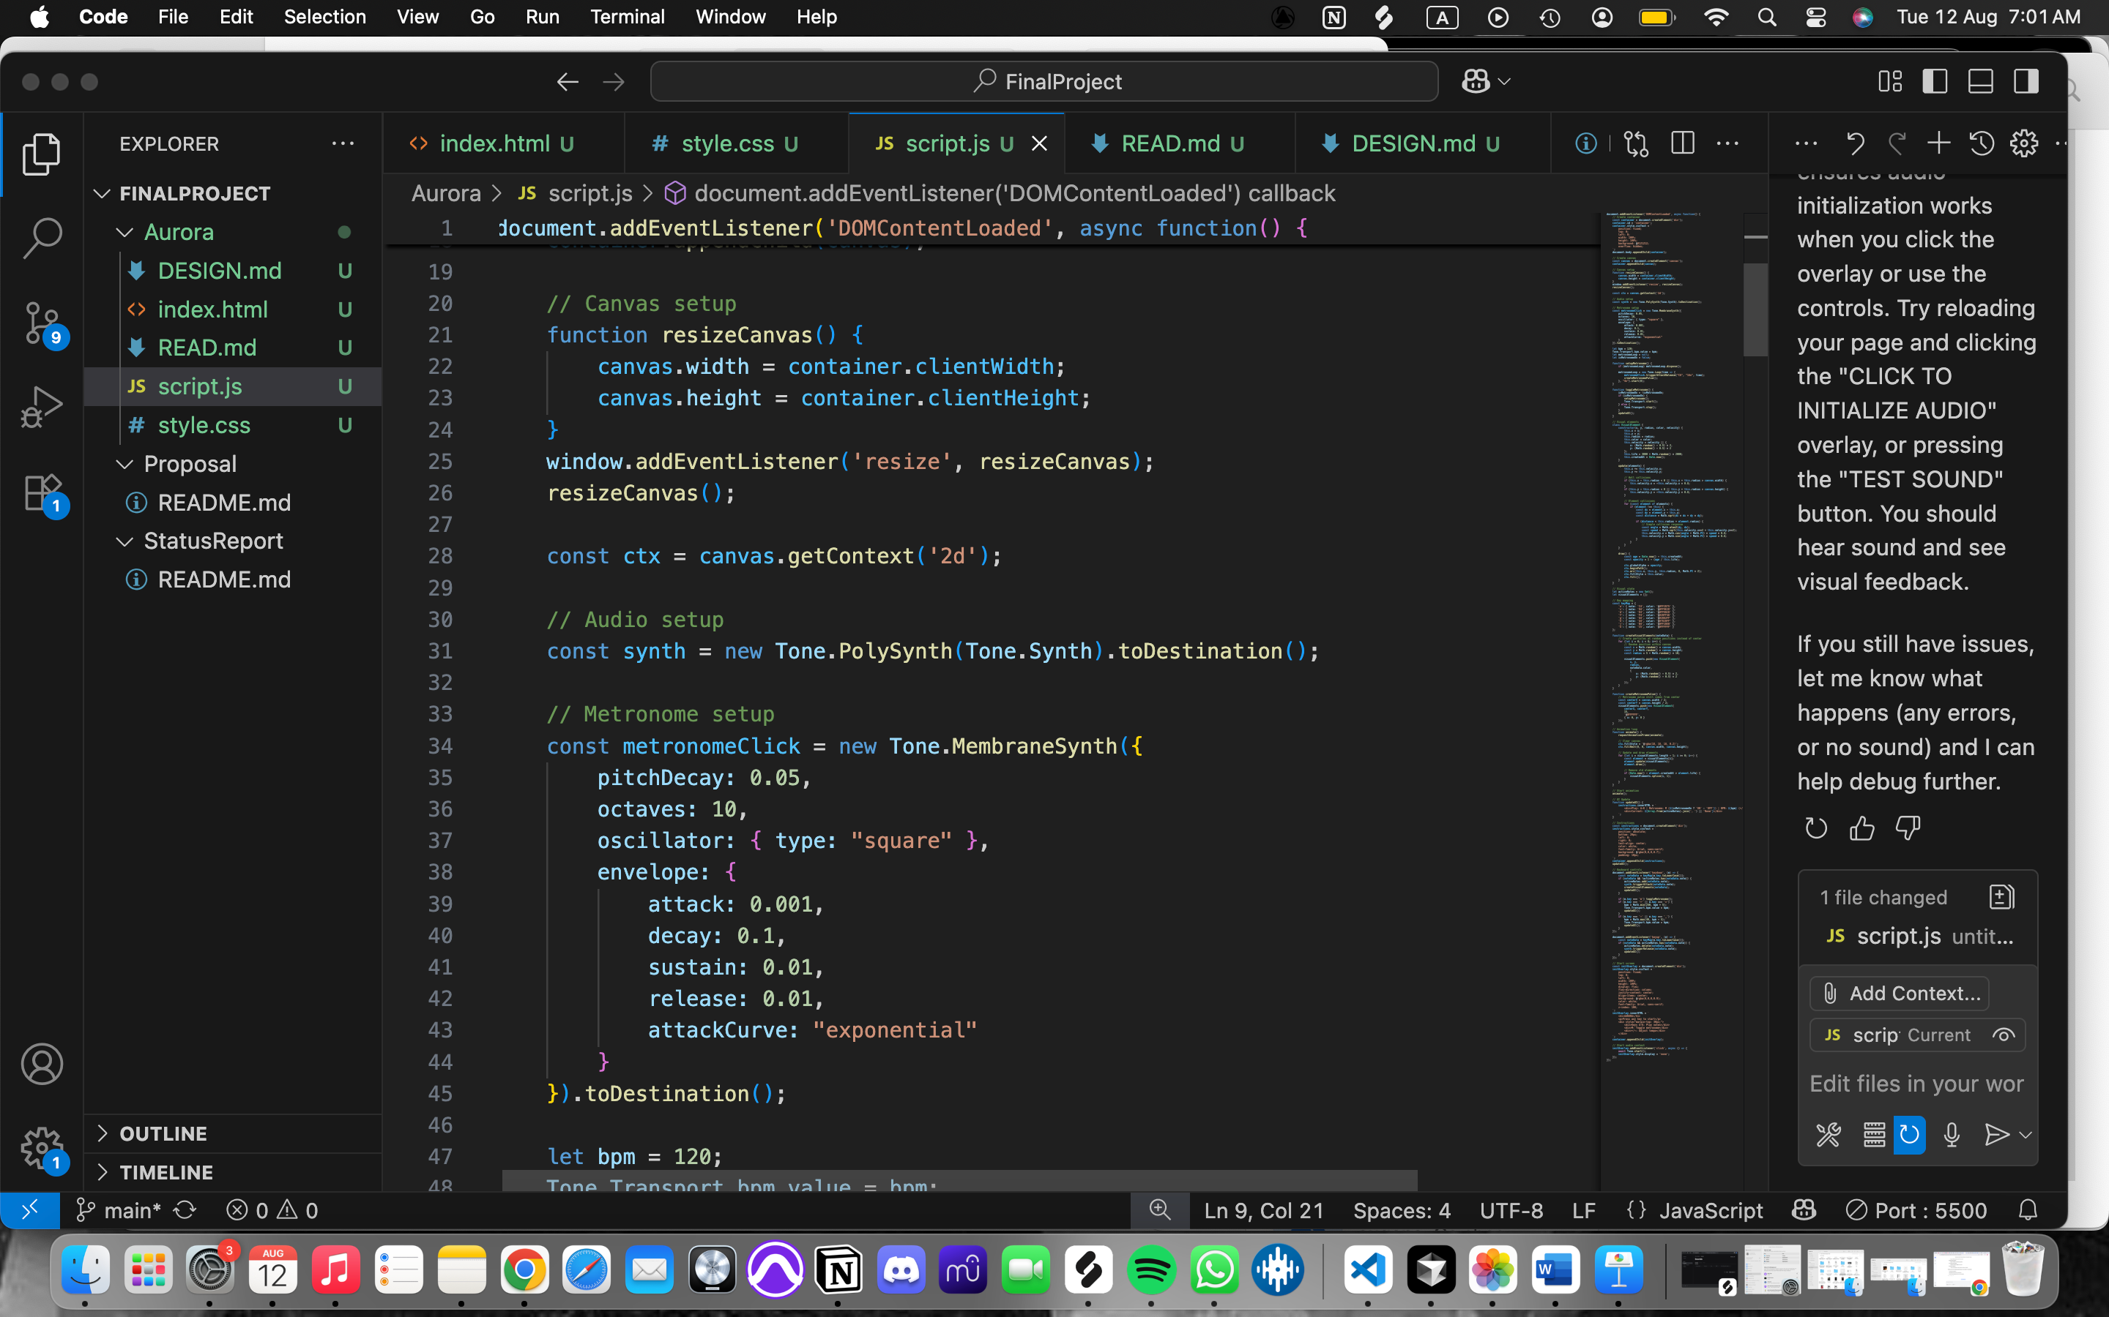
AUDIO ENGINE CORE
FOUNDATION OF THE ENTIRE AUDIO SYSTEM
POLYSYNTH: ENABLES CHORDS/ MULITIPLE NOTES AT ONCE
TONE.SYNTH: PROVIDES CLASSIC “SYNTH” SOUND
.TODESTINATION: SENDS SOUND TO SPEAKERS
METRONOME WITH SOUND
MEMBRANESYNTH (LIKE A DRUM MACHINE)
ATTACK: 0.001: CREATES SHARP, PERCUSSIVE CLICKS
OCTAVES: 10 ADDS HIGH FREQUENCY BRIGHTNESS
(03)

Slide 7
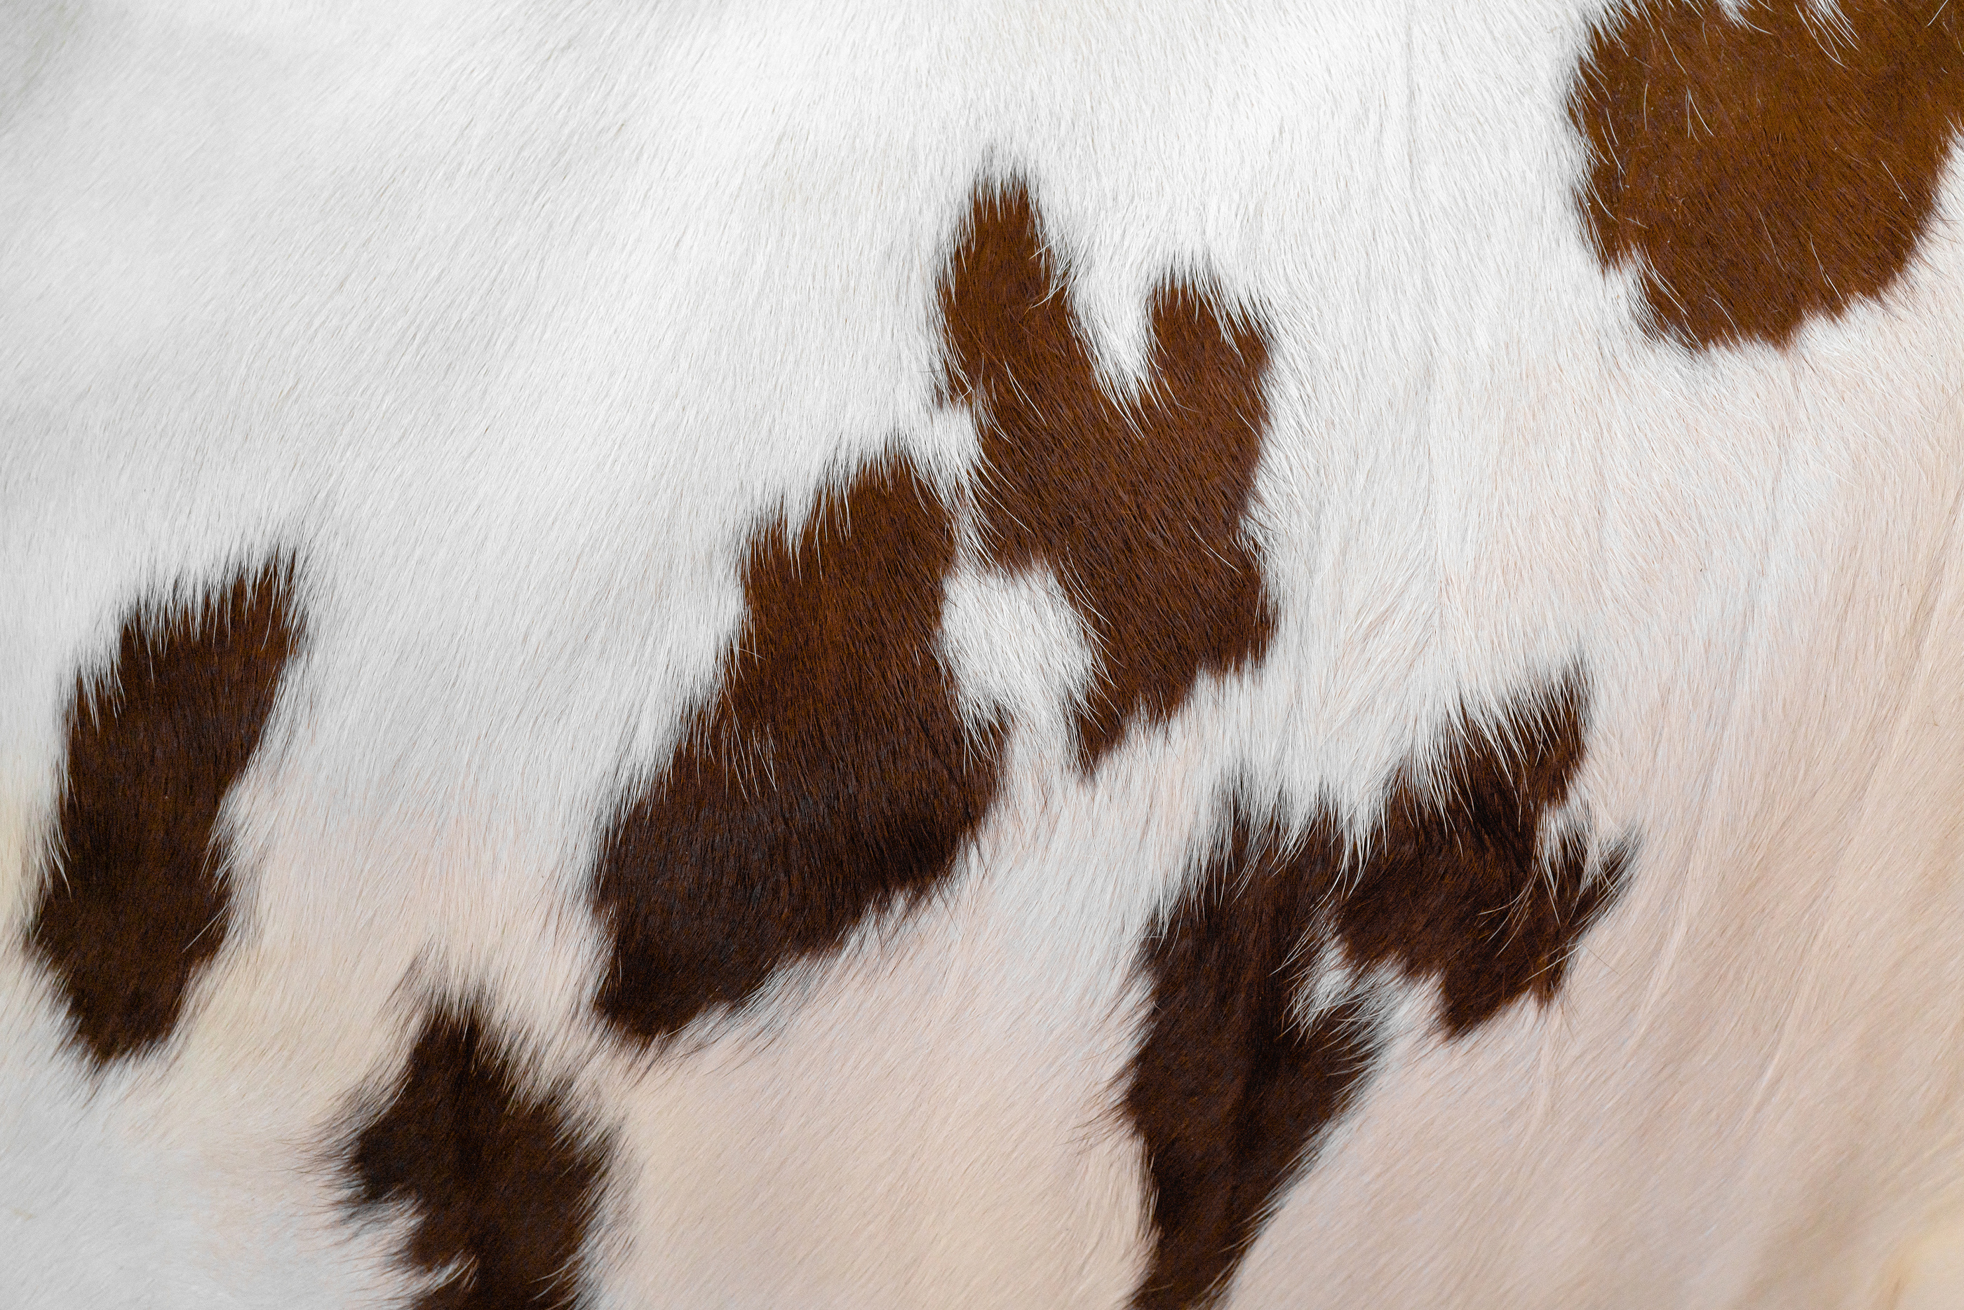
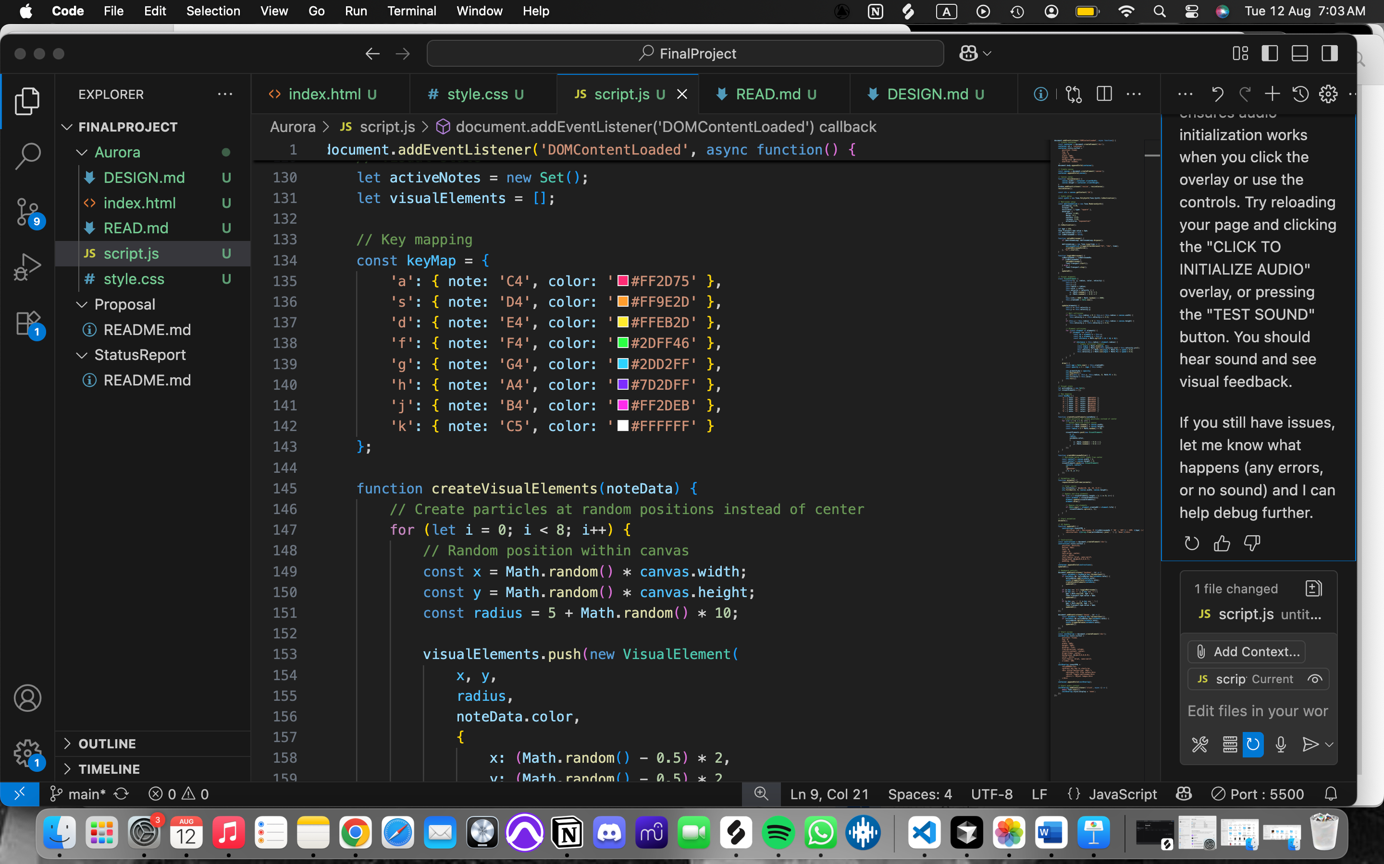
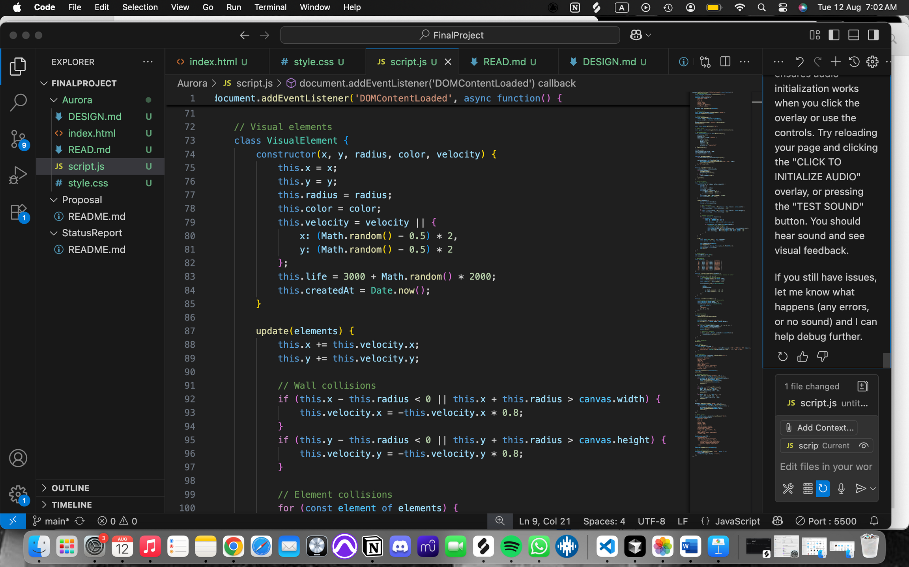
VISUALS
EACH PARTICLES HAVE DIFFERENT PHYSICS
VELOCITY CREATES ORGANIC MOTION
LIFE PROPERTY AUTO-RECYCLES PARTICLES
NOTE - COLOR
(3)
CREATES MUSICAL COLOR ASSOCIATIONS
HEX CODES CHOSEN
CHROMATIC SCALE

Slide 8
ACCOMPLISHMENTS
WHAT WORKS?
Full polyphonic playback (multiple notes at once).
Smooth particle collisions/fading.
Responsive BPM adjustments (40–240).

Slide 9


add effects (reverb/delay) , Tone.js
turn into a plug-in with more advanced features
more patterns
FUTURE
WORK

Slide 10
THANK
YOU !
PRESENTED BY
CECELIA LEE

